Slide 1
Internet of bins
Georgi Dimitrov, Adriano Izzi, Lorenzo Frangella

Slide 2
Project development core parts
networking
Sensors deployment
The communication algorithm developed.
Sensors used in the project development
ALarms and regression
The nodes send alarms and adjust parameters

Slide 3

Overview - Networking protocol
Nodes self organize themselves in a structured DAG topology to exchange messages. The Root bin has also acts as gateway.

Slide 4
Algorithm - Networking protocoL
First of all, they wake up at the start of the round trough RTC
LV 0
LV 1
LV 2
LV 3
WAKE UP!

Slide 5
Algorithm - Networking protocoL
For five seconds, all nodes make measurements
LV 0
MEASURE
LV 1
MEASURE
LV 2
MEASURE
LV 3
MEASURE

Slide 6
Algorithm - Networking protocoL
Based on level and time windows, they send and receive messages in the Forward round
LV 0
MEASURE
LV 1
MEASURE
LV 2
MEASURE
RECEIVE
LV 3
MEASURE
SEND

Slide 7
Algorithm - Networking protocoL
Based on level and time windows, they send and receive messages in the Forward round
LV 0
MEASURE
LV 1
MEASURE
RECEIVE
LV 2
MEASURE
RECEIVE
SEND
LV 3
MEASURE
SEND

Slide 8
Algorithm - Networking protocoL
Based on level and time windows, they send and receive messages in the Forward round
LV 0
MEASURE
RECEIVE
LV 1
MEASURE
RECEIVE
SEND
LV 2
MEASURE
RECEIVE
SEND
LV 3
MEASURE
SEND

Slide 9
Algorithm - Networking protocoL
The level 0 node, the gateway, trasmit the alarms trough MQTT
LV 0
MEASURE
RECEIVE
TRANSMIT
LV 1
MEASURE
RECEIVE
SEND
LV 2
MEASURE
RECEIVE
SEND
LV 3
MEASURE
SEND

Slide 10
Algorithm - Networking protocoL
During Response round, starting from the gateway, the nodes quickly receive and send messages to synchronyze RTC
LV 0
MEASURE
RECEIVE
TRANSMIT
SYNC
LV 1
MEASURE
RECEIVE
SEND
SYNC
LV 2
MEASURE
RECEIVE
SEND
SYNC
LV 3
SYNC
MEASURE
SEND

Slide 11
Algorithm - Networking protocoL
The nodes sleep, waiting for the next round…
LV 0
MEASURE
RECEIVE
TRANSMIT
SYNC
LIGHT SLEEP…
LV 1
LIGHT SLEEP…
MEASURE
RECEIVE
SEND
SYNC
LV 2
LIGHT SLEEP…
MEASURE
RECEIVE
SEND
SYNC
LV 3
SYNC
MEASURE
SEND
LIGHT SLEEP…
WAKE UP!

Slide 12
key concepts - Networking protocol
A new node start overhearing waiting for sync messages
A node level is defined by the lowest node it can hear trough LoRa
The maximum level of the tree is 4, since it can cover over 40 km of diameters
Nodes send their message only if there is an alarm
Nodes send all message they have received in that Forward round

Slide 13
Security - Networking protocol
All nodes share a secret key to create and verify hashes
During installation, the key is…
At runtime, the key is…
Not harcoded into the .elf
Trasmitted trough bluetooth when the bin is installed (special app has been developed for that)
Used toghether with message details to create hash
Used toghether with message details to verify hashes

Slide 14
development - Networking protocol
Originally, the protocol was much more complex and dynamic.
It was able to sustain an arbitrary number of levels and dynamic topologies.
Yet, due to minor but unfixable bugs related to LoRa (they eluded us for two weeks), we decided to simplify it and focus on other parts of the project.
The old code is avaiable to read trough Github commits

Slide 15

Types - SENSORS
TEMPERATURE
Filling level
To avoid the insurgence of fire
Ultrasound sensors to measure distance from the top of the bin to the garbage
Time
Bad Gas level
To know time passed since last collection and avoid foul smells
Gas sensors to
detect foul smells

Slide 16
Employed - SENSORs
TEMPERATURE
Filling level
To avoid the insurgence of fire
Ultrasound sensors to measure distance from the top of the bin to the garbage
Time
To know time passed since last collection and avoid foul smells
Bad Gas level
Gas sensors to
detect foul smells

Slide 17
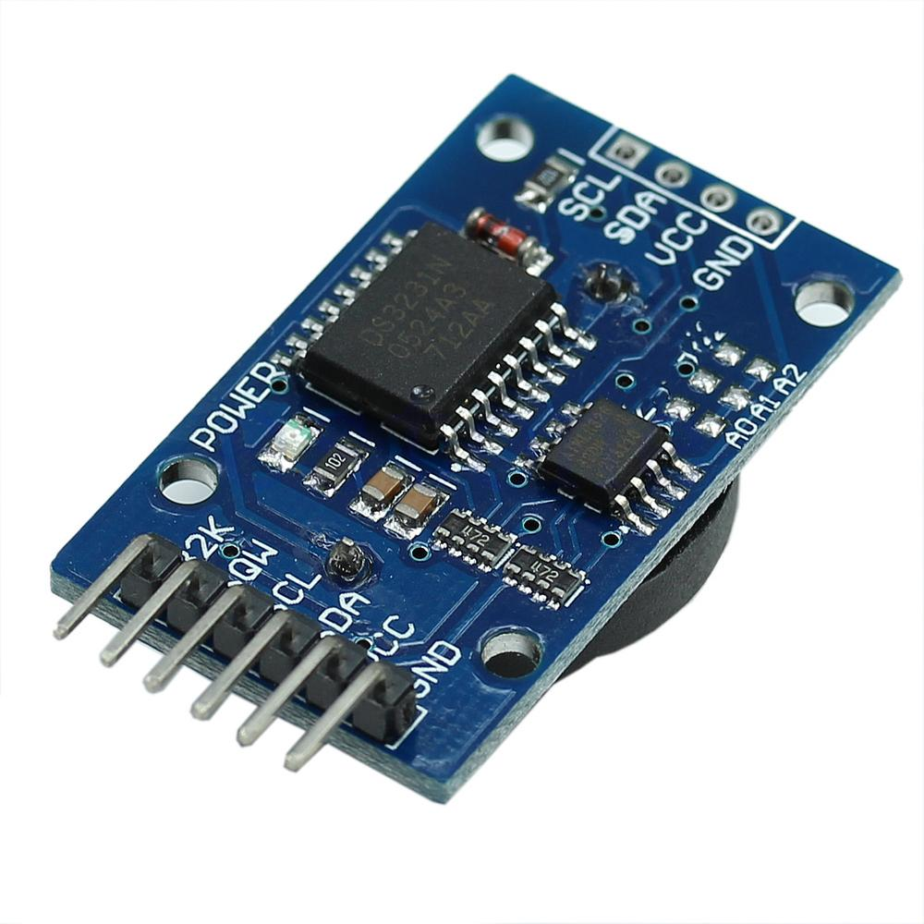
Employed - SENSORs
TEMPERATURE
Filling level
To avoid the insurgence of fire
Ultrasound sensors to measure distance from the top of the bin to the garbage
Time
To know time passed since last collection and avoid foul smells
Bad Gas level
Gas sensors to
detect foul smells

Slide 18
Employed - SENSORs
TEMPERATURE
Filling level
To avoid the insurgence of fire
Ultrasound sensors to measure distance from the top of the bin to the garbage
Time
To know time passed since last collection and avoid foul smells
Bad Gas level
Gas sensors to
detect foul smells

Slide 19
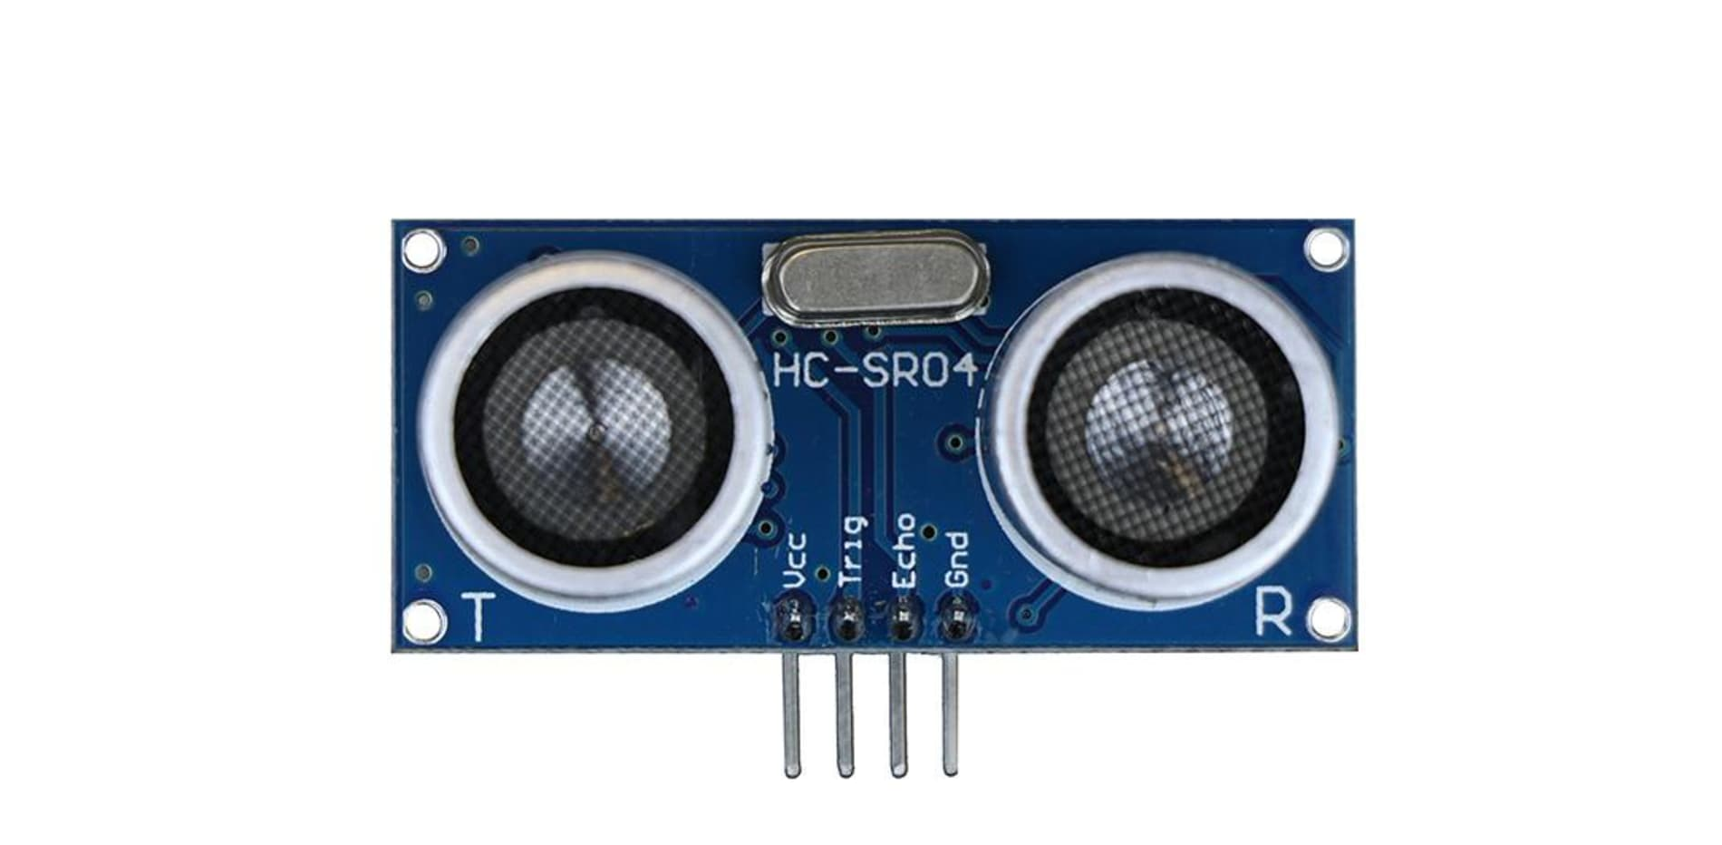
Employed - SENSORs
TEMPERATURE
Filling level
To avoid the insurgence of fire
Ultrasound sensors to measure distance from the top of the bin to the garbage
Time
To know time passed since last collection and avoid foul smells
Bad Gas level
Gas sensors to
detect foul smells

Slide 20
Employed - SENSORs
TEMPERATURE
Filling level
To avoid the insurgence of fire
Ultrasound sensors to measure distance from the top of the bin to the garbage
Time
To know time passed since last collection and avoid foul smells
Bad Gas level
Gas sensors to
detect foul smells

Slide 21
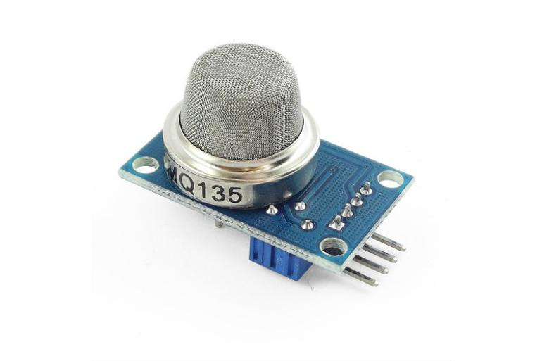
Employed - SENSORs
TEMPERATURE
Filling level
To avoid the insurgence of fire
Ultrasound sensors to measure distance from the top of the bin to the garbage
Time
To know time passed since last collection and avoid foul smells
Bad Gas level
Gas sensors to
detect foul smells

Slide 22
alarms - SENSORS
TEMPERATURE
Filling level
Uses dynamic calculation to send alert
If above 85%, send alarm
Under 40°, nothing
40° - 50°, alert
Over 50°, alarm
Time
Bad Gas level
Interrupt on pin 25 when time to wake up
Uses temperature and time passed to send alert
If above treshold, send alarm

Slide 23

Filling level thresholds - SENSORS
The filling level tresholds dynamically reconfigure over time.
Node keeps track of:
Tresholds are:
Filling rate since last gathering
Average time passed between gathering
If $FillingRate X TimeToGather+FillingLevel≥100$
then send alert
If Filling level is above 85%, send alarm

Slide 24
Server side - Mqtt
We used a MQTT protocol (actually HiveMQ) to send messages from the gateway and read them server side.
Geodata of the bins (taken at configuration time) and alarms can be used by other services to implement trash gathering

Slide 25
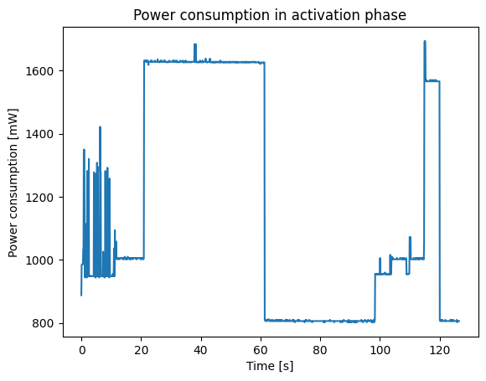
Standard node - Consumption
Here we can see the following phases:
Activation
Bluetooth
Discovering
Light Sleep
Measuring
Receiving
Sending
Sync
Light Sleep

Slide 26
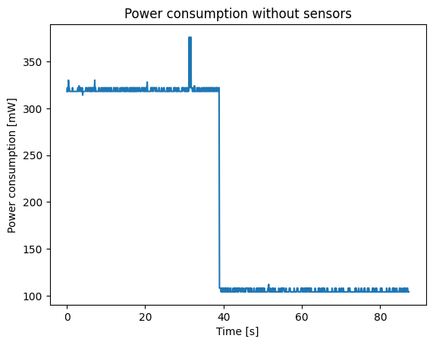
Standard node No Sensors - Consumption
Here we can see the following phases:
Receiving
Sync
Light Sleep

Slide 27
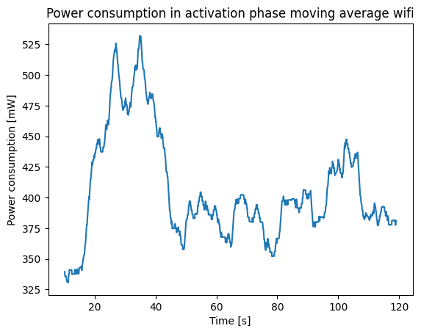
Gateway activation no sensors - Consumption
Here we can see the following phases:
Bluetooth
Wifi
SNTP

Slide 28

Energy and POwer- Consumption
Assuming that the system wake up each hour, the average energy consumption for hour is:
$$\left(AVG_{DUTY}∗TIME_{DUTY}+AVG_{SLEEP} ∗TIME_{REMAINING}\right)+AVG_{SLEEP}∗59 ∗60$$
=
$$\text{(1110 * 20 + 100 * 40) + 100 * 59 * 60}$$
=
380.200 mW
So the average power consuption for a day is 105,5 mW.
So if we want to power the system for few days we need a battery of:
$$105,5 ∗48=5064 mWh$$

Slide 29
Energy and POwer- Consumption
Since we need the bins to be active for years, we assume that there is a mechanism for energy harvesting to recharge the batteries.

Slide 30
Thanks for the attention!

